Slide 1

Overview on RAGAS
CREATED BY :
Gaurav Kumar
AKSHAY Rajguru
sushmitA SINGH
Madhusmita Manik
Bharghav

Slide 2



Overview on RAGAS
TRAINERS of the day
Gaurav kumar
Akshay Rajguru
sushmitA SINGH
DC MANAGER
Dc consultant
Dc senior consultant

Slide 3
Prerequisites Before We Start Training-
1. Create OpenAI account and get the OpenAI API Key-
https://medium.com/@lorenzozar/how-to-get-your-own-openai-api-key-f4d44e60c327
2. OpenAI GPT model used: gpt-3.5-turbo
3. Launch any IDE (recommended - VS Code) With Python >= 3.12.
4. Install below Python packages using command:
pip install ragas==0.1.10 datasets==2.20.0 openai==1.31.1 transformers==4.44.2 pandas==2.2.2 langchain==0.2.2 langchain-openai==0.1.8 langchain-community==0.2.3 langchain-text-splitters==0.2.2
Python Packages-
ragas==0.1.10
datasets==2.20.0
openai==1.31.1
transformers==4.44.2
pandas==2.2.2
langchain==0.2.2
langchain-openai==0.1.8
langchain-community==0.2.3
langchain-text-splitters==0.2.2

Slide 4
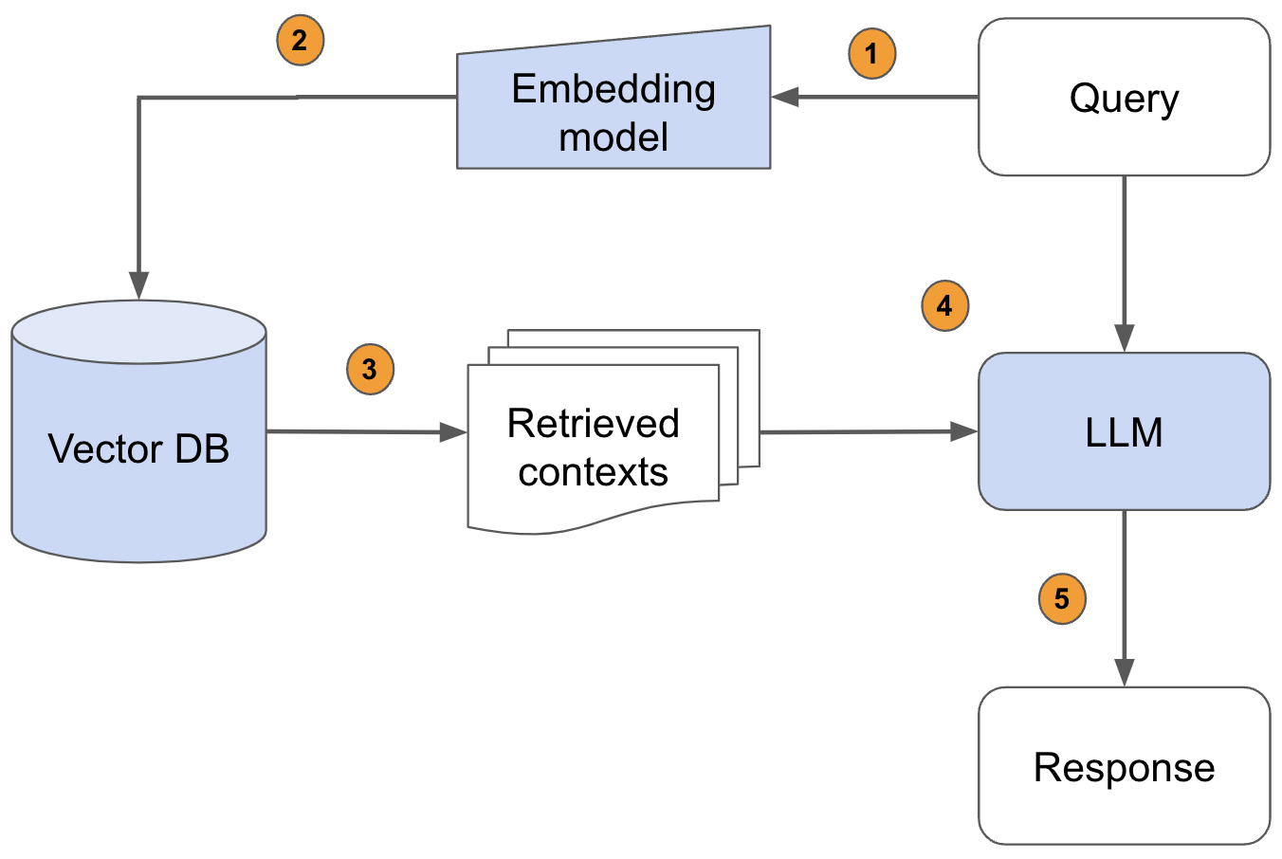
RAG: An easy and popular way to use your own data is to provide it as part of the prompt with which you query the LLM model. This is called retrieval augmented generation (RAG), as you would retrieve the relevant data and use it as augmented context for the LLM.
RAGAS:
Retrieval-Augmented Generation Application System,
designed to test the effectiveness of language and embedding models by simulating real-world queries and assessing the responses.
Input to RAG Evaluation​ Framework:
Question (User)​
Ground Truth (Actual Answer)​
What to evaluate ?
Answer (LLM)– Generated component
Retrieved Context (RAG)– Retrieved component

Slide 5

Introduction to RAGAS – Core Concepts
Ragas (Retrieval-Augmented Generation Application System) is a framework that helps you evaluate your Retrieval Augmented Generation (RAG) pipelines
Ragas aims to create an open standard, providing developers with the tools and techniques to leverage continual learning in their RAG applications.
Metrics Driven Development
Ragas’ vision is to facilitate the continuous improvement of LLM and RAG applications by embracing the ideology of Metrics-Driven Development (MDD).
Open-source standard for applying MDD to LLM and RAG applications:
Evaluation – Assess LLMs and experiments with metric aid for reliability.
Monitoring– Gain insights from data for LLM quality improvement.
Ragas Metrics
Ragas offers metrics tailored for evaluating each component of your RAG pipeline in isolation.
Ragas Score:
Faithfulness – How factually accurate is generated answer.
Answer Relevancy – Relevancy of the generated answer to the question.
Context Precision – Is retrieved context relevant to the query?
Context Recall – Can it retrieve all relevant information required to answer the question.
Synthetic Test Data Generation
By using synthetic data generation developer time in data aggregation process can be reduced by 90%.
Ragas achieves this by employing an evolutionary generation paradigm, where questions with different characteristics such as reasoning, conditioning, multi-context, and more are systematically crafted from the provided set of documents.
Utilizing User Feedback
User feedback can often be noisy and challenging to harness effectively.
Ragas is equipped to assist you in the analysis of user feedback data, enabling the discovery of patterns and making it a valuable resource for continual improvement.

Slide 6
Metrics Driven Development - Evaluation
Once the test set is ready using synthetic test set generation, next step is to evaluate your RAG pipeline
Points to remember…..
Evaluate RAG pipeline components individually and collectively to identify improvement areas.
Quantitative assessments with specific metrics and datasets are essential to gauge performance enhancements.
In Depth Evaluation
To evaluate the RAG pipeline, RAGAs expects the following information:
question: The user query that is the input of the RAG pipeline.
contexts: The contexts retrieved from the external knowledge source used to answer the question.
ground_truths: The ground truth answer to the question. This can be human-annotated or synthetically generated using RAGAS information.
Contextual Reference Data
Evaluation Metrics of RAG pipeline
generation
retrieval
User Questions
faithfulness
context precision
How factually accurate is generated answer
Signal to noise ratio to received context.
Ground truth Answered
RAG EVALUATION
answer relevancy
context recall
Relevancy of the generated answer to the question
Can it retrieve all relevant information required to answer the question.
RAG generated answer

Slide 7
1
Ragas Metrics - Faithfulness
This measures the factual consistency of the generated answer against the given context. It is calculated from answer and retrieved context. The answer is scaled to (0,1) range. Higher the better.
0
|Number in the generated answer that can be inferred from give context|
Ragas Score
Faithfulness Score =
generation
retrieval
|Total Number of claims/statements in the generated answer|
faithfulness
context precision
How factually accurate is generated answer
Signal to noise ratio to received context.
Example:
Question: Where and when was Einstein born?
answer relevancy
context recall
Relevancy of the generated answer to the question
Can it retrieve all relevant information required to answer the question.
Low Faithful Context: Albert Einstein was a German-born theoretical physicist, widely held to be one of the greatest and most influential scientists of all time.
High Faithful Context: Albert Einstein (born 14 March 1879) was a German-born theoretical physicist, widely held to be one of the greatest and most influential scientists of all time.
Calculation:
Step 1: Break the generated answer into individual statements.
Claims:
Claim/statement 1: “Einstein was born in Germany.”
Claim/Statement 2: “Einstein was born on 20th March 1879.”
Step 2: For each of the generated statements, verify if it can be inferred from the given context.
Statement 1: Yes
Statement 2: No
Step 3: Use the formula depicted above to calculate faithfulness.
Calculation:
Step 1: Break the generated answer into individual statements.
Claims:
Claim/statement 1: “Einstein was born in Germany.”
Claim/Statement 2: “Einstein was born on 14th March 1879.”
Step 2: For each of the generated statements, verify if it can be inferred from the given context.
Statement 1: Yes
Statement 2: Yes
Step 3: Use the formula depicted above to calculate faithfulness.
Faithfulness Score = 1/2 = 0.5
Faithfulness Score = 2/2 = 1
Better Score
Notes:
Context is fetched from chunking stored in Vector DB. Better is chunking more accurate is context given to RAG pipeline.

Slide 8
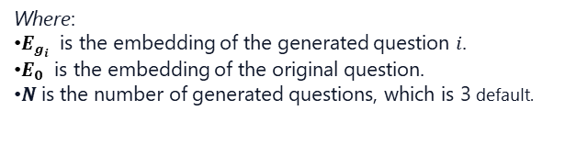
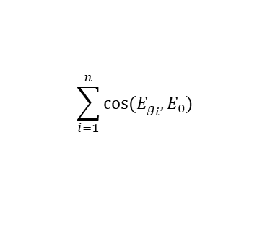
Ragas Metrics – Answer Relevancy
1
Answer Relevancy, focuses on assessing how pertinent the generated answer is to the given prompt. A lower score is assigned to answers that are incomplete or contain redundant information and higher scores indicate better relevancy.
0
$$\sum_{i=1}^{n}{cos⁡(E_{g_{i}},E_{0})}$$
Ragas Score
mean cosine similarity of the original question to a number of artificial questions
=
generation
retrieval
1/N
faithfulness
context precision
Answer Relevancy =
Signal to noise ratio to received context.
Where:
$E_{g_{i}}$ is the embedding of the generated question 𝑖.
$E_{0}$ is the embedding of the original question.
𝑁 is the number of generated questions, which is 3 default.
How factually accurate is generated answer
answer relevancy
context recall
Relevancy of the generated answer to the question
Can it retrieve all relevant information required to answer the question.
Example:
Question: Where is France and what is its capital?
Fact:
Even though in practice the score will range between 0 and 1 most of the time, this is not mathematically guaranteed, due to the nature of the cosine similarity ranging from -1 to 1.
Calculation:
Step 1: Reverse-engineer ‘n’ variants of the question from the generated answer using a Large Language Model (LLM). For instance, for the first answer, the LLM might generate the following possible questions:
Question 1: “In which part of Europe is France located?”
Question 2: “What is the geographical location of France within Europe?”
Question 3: “Can you identify the region of Europe where France is situated?”
Step 2: Calculate the mean cosine similarity between the generated questions and the actual question.
To calculate this score, the LLM is prompted to generate an appropriate question for the generated answer multiple times, and the mean cosine similarity between these generated questions and the original question is measured.
The underlying idea is that if the generated answer accurately addresses the initial question, the LLM should be able to generate questions from the answer that align with the original question.
Low relevance answer: France is in western Europe.
High relevance answer: France is in western Europe and Paris is its capital.

Slide 9
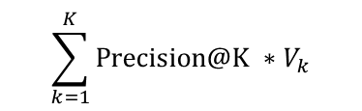
1
Ragas Metrics – Context Precision
Context Precision is a metric that evaluates whether all of the ground-truth relevant items present in the contexts are ranked higher or not. All the relevant chunks must appear at the top ranks. This metric is computed using the question, ground_truth and the contexts, with values ranging between 0 and 1.
0
$$\sum_{k=1}^{K}{Precision@K ∗V_{k}}$$
Ragas Score
generation
retrieval
Context Precision@K =
faithfulness
context precision
Total Number of relevant items in the top K results
How factually accurate is generated answer
Signal to noise ratio to received context.
Where:
K is the total number of chunks in contexts
$V_{k}$ is relevance indicator at rank k
answer relevancy
Relevancy of the generated answer to the question
context recall
Can it retrieve all relevant information required to answer the question.
Example:
Question: Where is France and what is its capital?
Ground truth: France is in Western Europe and its capital is Paris.
Calculation:
Step 1:For each chunk in retrieved context, check if it is relevant or not relevant to arrive at the ground truth for the given question.
Step 2: Calculate precision@k for each chunk in the context.
Step 3: Calculate the mean of precision@k to arrive at the final context precision score.

Slide 10
1
Ragas Metrics – Context Recall
Context recall measures the extent to which the retrieved context aligns with the annotated answer, treated as the ground truth. It is computed based on the ground truth and the retrieved context, and the values range between 0 and 1. Higher the better
0
Ragas Score
|GT sentences that can be attributed to the context|
generation
retrieval
Context Recall =
faithfulness
context precision
|Number of sentences in GT|
How factually accurate is generated answer
Signal to noise ratio to received context.
answer relevancy
context recall
Example:
Question: Where is France and what is its capital?
Ground truth: France is in Western Europe and its capital is Paris.
Relevancy of the generated answer to the question
Can it retrieve all relevant information required to answer the question.
Context: France, in Western Europe, encompasses medieval cities, alpine villages and Mediterranean beaches. The country is also renowned for its wines and sophisticated cuisine. Lascaux’s ancient cave drawings, Lyon’s Roman theater and the vast Palace of Versailles attest to its rich history.
Context: France, in Western Europe, encompasses medieval cities, alpine villages and Mediterranean beaches. Paris, its capital, is famed for its fashion houses, classical art museums including the Louvre and monuments like the Eiffel Tower.
Calculation:
Step 1: Break the generated answer into individual statements.
Claims:
Statement 1: “France is in western Europe.”
Statement 2: “Its capital is Paris.”
Step 2: For each of the generated statements, verify if it can be inferred from the given context.
Statement 1: Yes
Statement 2: Yes
Step 3: Use the formula depicted above to calculate faithfulness.
Calculation:
Step 1: Break the ground truth answer into individual statements.
Statements:
Statement 1: “France is in western Europe.”
Statement 2: “Its capital is Paris.”
Step 2: For each of the ground truth statements, verify if it can be attributed to the retrieved context.
Statement 1: Yes
Statement 2: No
Step 3: Use the formula depicted above to calculate faithfulness.
Context Recall = 1/2 = 0.5
Context Recall = 2/2 = 1
Better Score

Slide 11
Troubleshooting RAGAS Metrics: What Low Scores Mean and How to Respond
Sr. No. | Metric | What a Low Score Indicates | Recommended Debugging & Actions
1 | Faithfulness | The generated answer is not supported by the retrieved context—model is hallucinating or inventing information. | Refine prompt to instruct LLM to only use provided context. Review retrieval quality: Are relevant documents being fetched? Ensure context is correctly passed to the LLM. Consider model fine-tuning for better grounding.
2 | Answer Relevancy | The answer does not address the user’s question; may be off-topic or nonsensical. | Check prompt clarity and specificity. Assess if the LLM understands the query. Validate that context is relevant to the question. Confirm proper formatting of inputs to the model.
3 | Context Precision | Most of the retrieved context is irrelevant to the question; retrieval returns noisy or off-topic passages. | Audit retrieval algorithm and configuration. Re-examine document indexing and chunking. Improve query formulation. Implement stricter filtering of retrieved results.
4 | Context Recall | The retriever fails to fetch relevant context that exists in the knowledge base; important information is missed. | Test alternative retrieval methods or embeddings. Ensure the knowledge base contains the needed information. Use query expansion techniques. Adjust document chunking strategy.

Slide 12
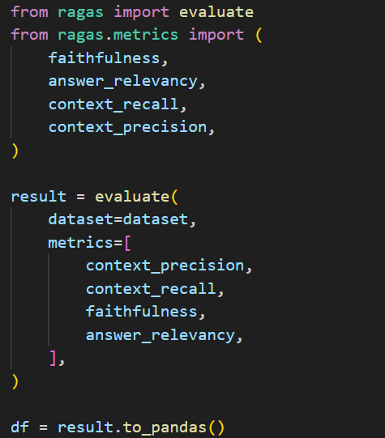
Code: Evaluation Metrics
OUTPUT:

Slide 13
Synthetic Test Data Generation
Why Synthetic test data?
Evaluating RAG (Retrieval-Augmented Generation) augmented pipelines is crucial for assessing their performance. Manual QA creation is slow and may lack complexity, impacting quality. Additionally, human-generated questions may struggle to reach the level of complexity required for a thorough evaluation, ultimately impacting the quality of the assessment. By using synthetic data generation developer time in data aggregation process can be reduced by 90%.
Ragas achieves the better performance of a RAG pipeline by employing an evolutionary generation paradigm (CRITIC LLM), where questions with different characteristics such as reasoning, conditioning, multi-context, and more are systematically crafted from the provided set of documents.
Reasoning
Evolution
Seed question
Conditioning
Multi-context
In Depth Evolution
Conditioning/Simple: Modify the question to introduce a conditional element, which adds complexity to the question.
Reasoning: Rewrite the question in a way that enhances the need for reasoning to answer it effectively.
Multi-Context: Rephrase the question in a manner that necessitates information from multiple related sections or chunks to formulate an answer.

Slide 14
Synthetic Test Data Generation: Test set evaluation distributions:
1. simple
Purpose: Generates straightforward, fact-based questions and answers.
Use Case: Tests the RAG system’s ability to retrieve and generate direct, factual responses from the provided context.
Example:
Question: "What year was the company founded?"
Answer: "2010"
2. reasoning
Purpose: Generates questions that require reasoning or inference, not just direct lookup.
Use Case: Evaluates the RAG system’s ability to combine multiple pieces of information or perform logical reasoning.
Example:
Question: "Who was the CEO when the company launched its first product?"
Answer: Requires connecting the CEO’s tenure with the product launch date.
3. multi_context
Purpose: Generates questions that require synthesizing information from multiple contexts or documents.
Use Case: Assesses the RAG system’s ability to aggregate and reason over information spread across several sources.
Example:
Question: "List all products launched by the company between 2010 and 2015."
Answer: Requires pulling data from multiple documents or sections.

Slide 15
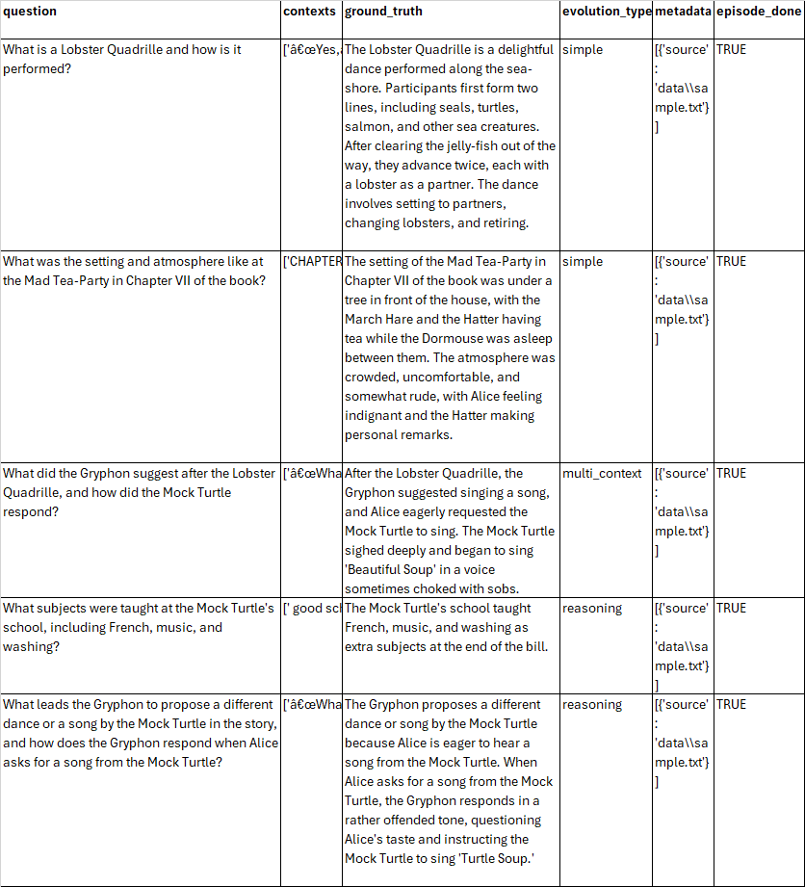
Code: Synthetic Test Data Generation
import os os.environ["OPENAI_API_KEY"] = "your-openai-key" # Load documents from directory from langchain_community.document_loaders import DirectoryLoader loader = DirectoryLoader("your-directory") documents = loader.load() for document in documents: document.metadata['filename'] = document.metadata['source'] # Create 5 samples using default configuration from ragas.testset.generator import TestsetGenerator from ragas.testset.evolutions import simple, reasoning, multi_context from langchain_openai import ChatOpenAI, OpenAIEmbeddings # generator with openai models model_name = "gpt-3.5-turbo" ... | ... generator_llm = ChatOpenAI(model=model_name) critic_llm = ChatOpenAI(model=model_name) embeddings = OpenAIEmbeddings() generator = TestsetGenerator.from_langchain( generator_llm, critic_llm, embeddings ) # Change resulting question type distribution distributions = { simple: 0.3, multi_context: 0.2, reasoning: 0.5 } # generate testset testset = generator.generate_with_langchain_docs(documents, test_size=5, distributions=distributions) # Export to Pandas testset.to_pandas()

Slide 16
Metrics Driven Development - Monitoring
Monitoring allows you to gain valuable and actionable insights from production data points, facilitating the continuous improvement of the quality of your LLM application.
Why Monitoring
Ensures the distribution of your production dataset remains consistent with the test set.
Effectively identifies areas that require attention in the RAG pipeline to improve its performance.
Constructs custom, smaller, more cost-effective, and faster models for evaluation and advanced test set generation.

Slide 17
Assignment
Create RAG (Retrieval Augmented Generation) app in Python that can let you query/chat with your PDFs/Text Files using generative AI.
Create Synthetic Test Data for the same document.
Evaluate the RAG responses using Synthetic Test Data and RAGAS metrics.
Python Packages
ragas==0.1.10
openai==1.31.1
transformers==4.44.2
pandas==2.2.2
langchain==0.2.2
langchain-openai==0.1.8
langchain-community==0.2.3
langchain-text-splitters==0.2.2

Slide 18

It's Quiz Time

Slide 19
Graveyard

Slide 20
References:
OpenAI-API-Key
https://platform.openai.com/docs/quickstart
https://openai.com/api/pricing/
https://medium.com/@lorenzozar/how-to-get-your-own-openai-api-key-f4d44e60c327
https://www.splendidfinancing.com/blog/how-to-get-an-openai-api-key-for-chatgpt
https://help.openai.com/en/articles/5112595-best-practices-for-api-key-safety
RAGAS:
https://docs.ragas.io/en/latest/getstarted/index.html
https://github.com/pixegami/rag-tutorial-v2
https://www.pinecone.io/learn/series/langchain/langchain-expression-language/
https://docs.ragas.io/en/stable/concepts/metrics/available_metrics/
Synthetic data generation using RAGAS:
CRITIC: https://arxiv.org/abs/2305.11738
Synthetic Test Data Generation : Complete guide: https://medium.com/@rupeshyadav153/evaluation-of-retrieval-augmented-generation-rag-using-ragas-on-human-annotated-and-synthetic-09c4b825c298

